Slide 1
BANK
LOAN
ANALYTICS

Slide 2

OUR TEAM MEMBERS
1) Sarfaraj Alam
2) Tanmay Ashok Khedekar
3) Rhea Rachel Samuel
4) Muhammad Jaseel VK
5) Poonam Kashinath Ukey
6) Ajamayin Baseer Loni
7) Mhetri Ashwini Prakash

Slide 3
KPI List & Data Overview
Objective: KPIs
Introduction
Objectives of Analysis
Conclusion
Analysis
Recommendations & Insights

Slide 4
Introduction
This project is an in-depth analysis of bank loan data, aimed at uncovering key insights into loan issuance trends, customer credit behavior, and financial performance metrics. The analysis combines SQL, Tableau, Excel and Power BI for data extraction and transformation into data visualization, providing a comprehensive overview of loan trends over time, the financial health of different customer segments and risk assessment across various loan grades. This project serves as a crucial tool for understanding the dynamics of loan portfolios and guiding strategic decision-making.in the financial sector.

Slide 5
Objectives of Analysis
Predict Loan Defaults
Identify potential defaulters using historical data and predictive modeling.
Helps banks reduce financial losses and improve risk management.
Objective 2: Assess Credit Risk
Analyze customer financial behavior to determine creditworthiness.
Enables better loan approval decisions with minimized risks.
Objective 3: Improve Loan Approval Strategies
Optimize loan approval criteria to balance profitability and risk.
Ensures fair, data-driven decision-making for customers.

Slide 6
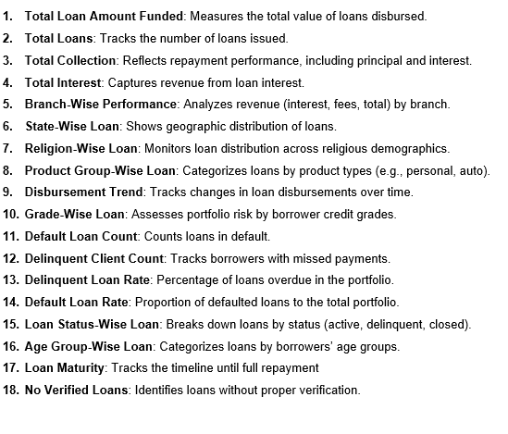
KPI List

Slide 7
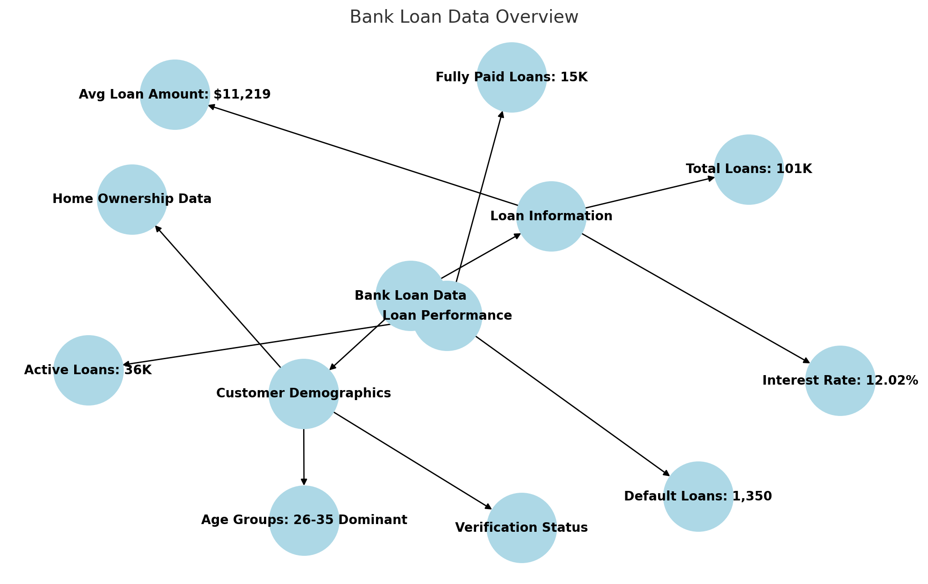
Data Overview
Zomato Data Set
15 Countries
141 Cities
9551 Restaurants
1825 Cuisine Served
2.89 Average Rating
1498K Votes
Dataset Overview
Structure: this Data set contain only one sheet, the sheet contain 53 columns and multiple rows.
Sheet: Contains core Banking details like customer details, loan details, payment history, and risk factors.
Key Insights
Majority (23K+) of borrowers are aged 26-35, making them the most active loan seekers.
Home ownership & verification status data have significant missing values.
Loans marked as NPA (Non-Performing Assets) indicate repayment issues.

Slide 8
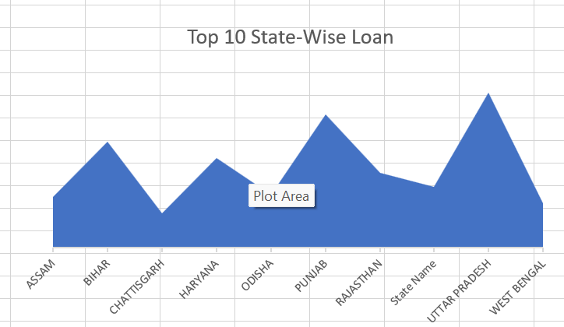
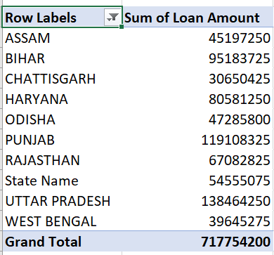
KPI 1:- Top 10 State wise Loan
.
Chart: Area chart showing state-wise loan distribution.
Key Insights:
Uttar Pradesh has the highest loan distribution (₹138.4M), followed by Punjab (₹119.1M) and Bihar (₹95.1M).
Haryana (₹8M), Odisha (₹4.7M), and West Bengal (₹3.9M) have relatively lower loan amounts.
The total loan amount across these top 10 states is ₹717.75M.
Loans are concentrated in a few states, indicating regional demand variations.

Slide 9
KPI 2: Loan Distribution by Product Group
Key Insights:
Home Loans dominate the product categories, receiving the highest loan disbursement.
Services and Business loans are the next most significant categories.
Emergency and Festive Loans have a lower share, indicating limited demand.
Loans for Mobile Phones and Production remain minimal compared to other categories.

Slide 10
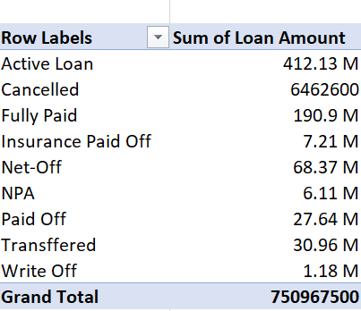
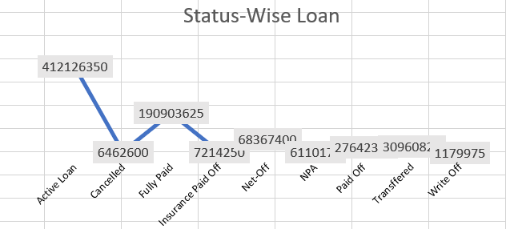
KPI 3: Status wise Loan
.
Key Insights:
Active Loans dominate with ₹412.13M, making up the largest share.
₹190.9M worth of loans are Fully Paid, indicating strong repayment trends.
Non-Performing Assets (NPA) stand at ₹6.11M, signaling potential risk.
Loan write-offs are minimal (₹1.18M), showing controlled bad debts.

Slide 11
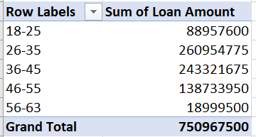
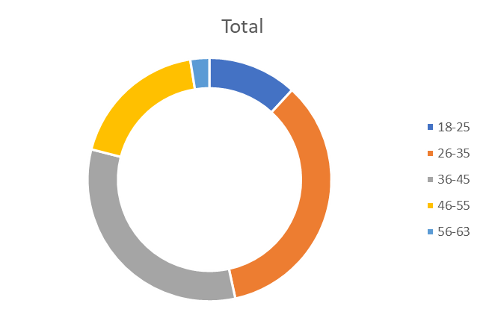
KPI 4:Age-Wise Loan Distribution
Key Insights:
Borrowers aged 26-35 form the largest group, indicating high loan demand in this segmen
The 36-45 age group is the second highest, showing significant financial activity.
Younger (18-25) and older (56-63) age groups have the least loan participation.
This data suggests that loan demand is highest among working professionals and middle-aged individuals.

Slide 12
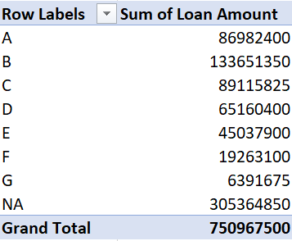
KPI 5: Loan Distribution by Grade
Key Insights:
Grade B and C loans dominate, receiving the largest share of total loan disbursement.
Grade A loans have a moderate presence, indicating lower risk preferences.
Lower-grade loans (E, F, G) form a smaller portion, suggesting stricter lending criteria for high-risk borrowers.
This analysis helps in understanding risk levels and creditworthiness trends among borrowers.

Slide 13
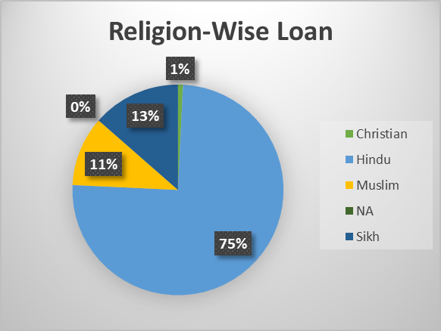
KPI 6: Religion-Wise Loan Distribution
.
Key Insights:
Hindus hold the majority (75%) of total loans, indicating significant borrowing activity.
Muslims (11%) and Sikhs (13%) have moderate loan distribution, showing diverse financial engagement.
Christians (1%) and NA (0%) have minimal loan representation, possibly due to different financial preferences or access.
This analysis provides insights into loan distribution among different religious groups, helping financial institutions tailor lending policies.

Slide 14
KPI 7:Delinquency Rate Analysis
.
Key Insights:
89.8% of loans are not delinquent (N), indicating a strong repayment trend.
10.2% of loans are delinquent (Y), highlighting a moderate level of risk in the loan portfolio.
A low delinquency rate suggests efficient loan management and responsible borrowing.
Financial institutions can further reduce delinquency through better risk assessment and borrower support programs.

Slide 15
Overall Analysis
Top loan-taking states: Uttar Pradesh, Punjab, and Bihar .Uttar Pradesh holds the highest loan amount, indicating high demand for credit. Variations in loan amounts across states suggest differences in economic activity and financial needs.
Mobile Loans dominate, followed by services and business-related loans. Agriculture and emergency loans have relatively lower amounts, indicating lower borrowing in these sectors. Understanding these trends helps financial institutions optimize loan offerings
Active loans contribute the most, with over $412M in outstanding credit. Fully paid loans ($190M) reflect a strong repayment trend. Net-offs, NPAs, and write-offs are comparatively lower, indicating controlled risk management.
The 26-35 and 36-45 age groups are the primary borrowers. Young borrowers (18-25) and older borrowers (56-63) contribute less, reflecting varied borrowing capacities. This information helps in targeted financial product offerings.
Loans are distributed across multiple risk grades (A to G).Higher-grade loans (A, B, C) receive a larger share, indicating safer lending. Lower-grade loans (F, G) have a smaller proportion, suggesting cautious lending practices.
Hindus (75%) take the majority of loans. Muslims (11%) and Sikhs (13%) hold smaller shares. Christian and NA categories contribute marginally.
89.8% of loans are non-delinquent, indicating healthy repayment behavior.10.2% delinquency rate suggests some borrowers struggle with repayments. Financial institutions can implement better credit risk strategies to minimize defaults.

Slide 16
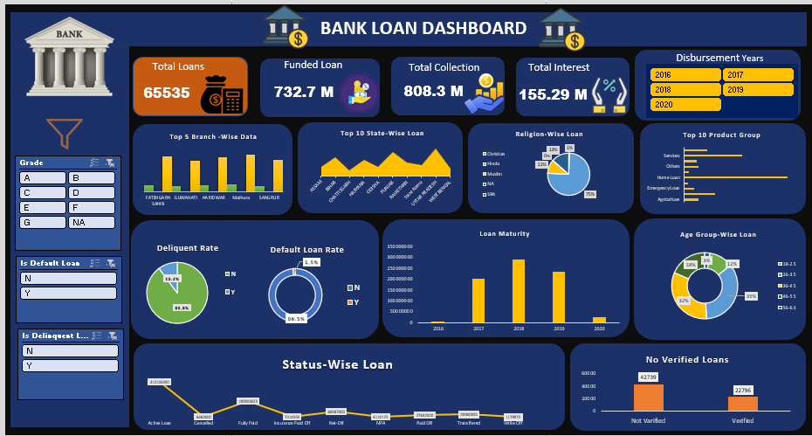
EXCEL DASHBOARD

Slide 17
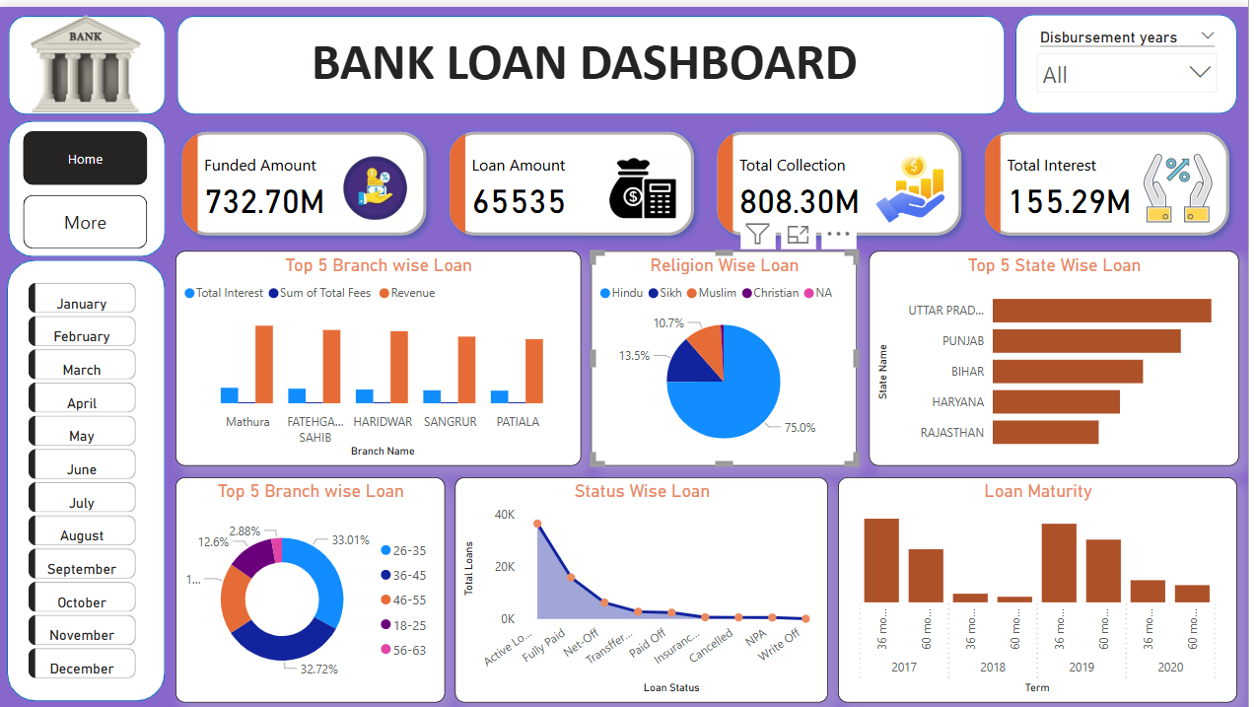
POWER BI DASHBOARD

Slide 18
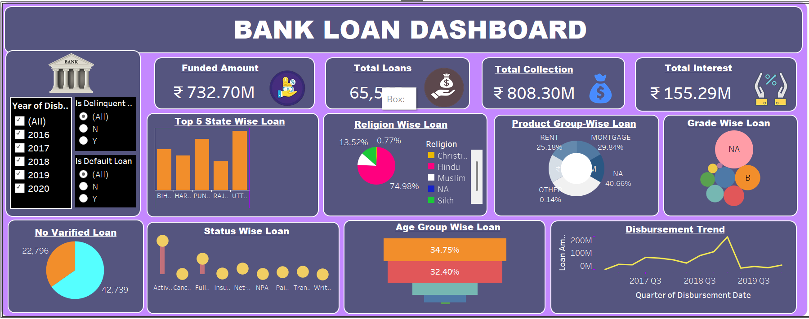
TABLEAU DASHBOARD

Slide 19
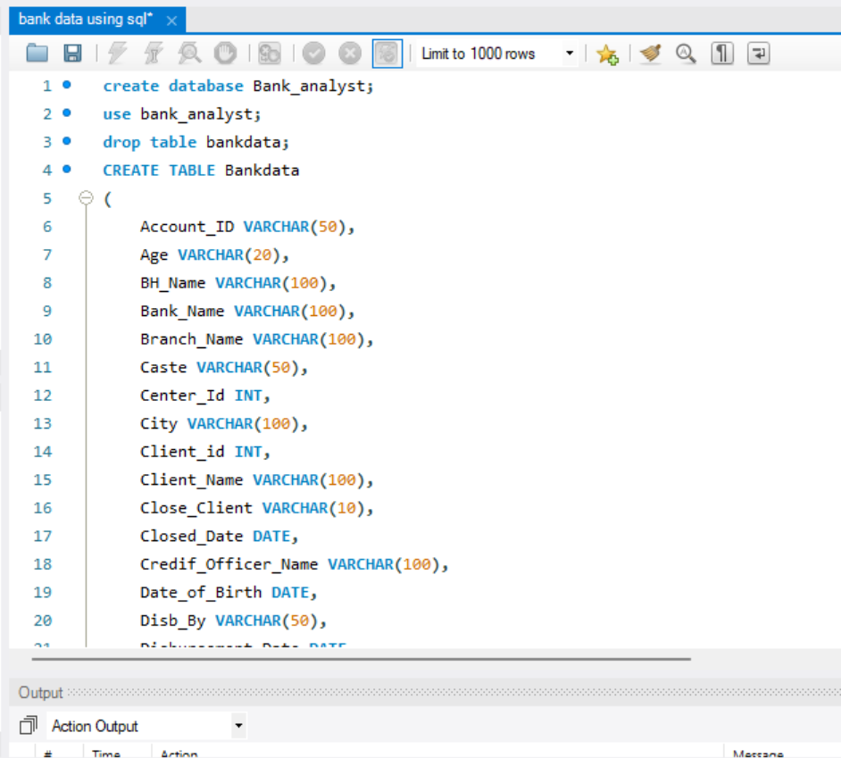
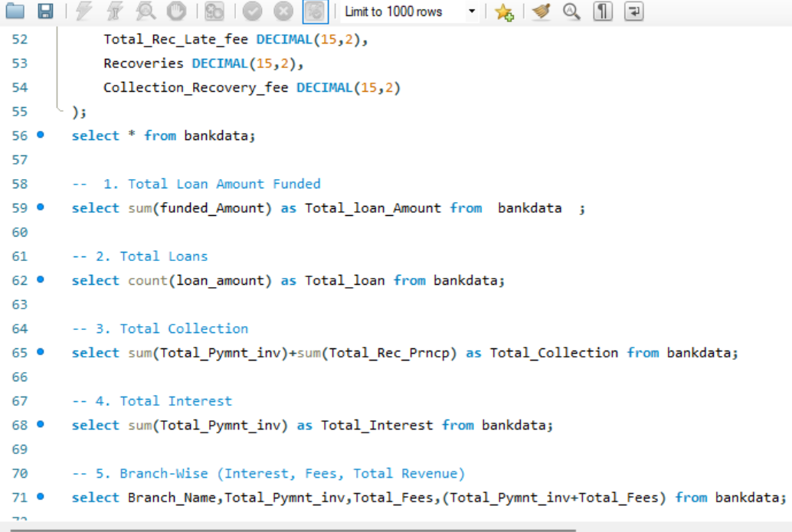
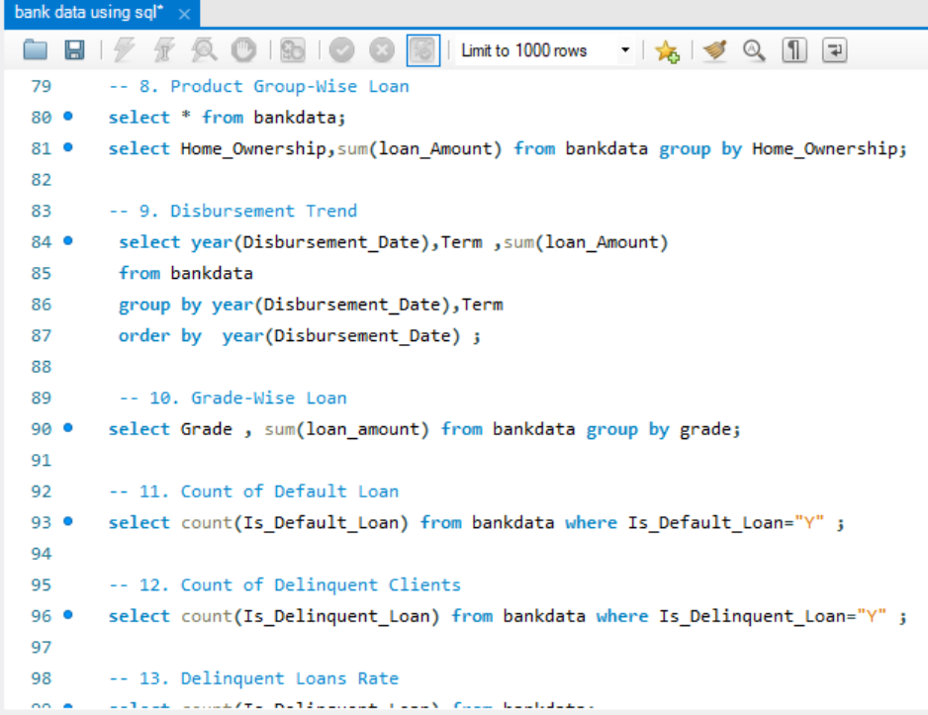
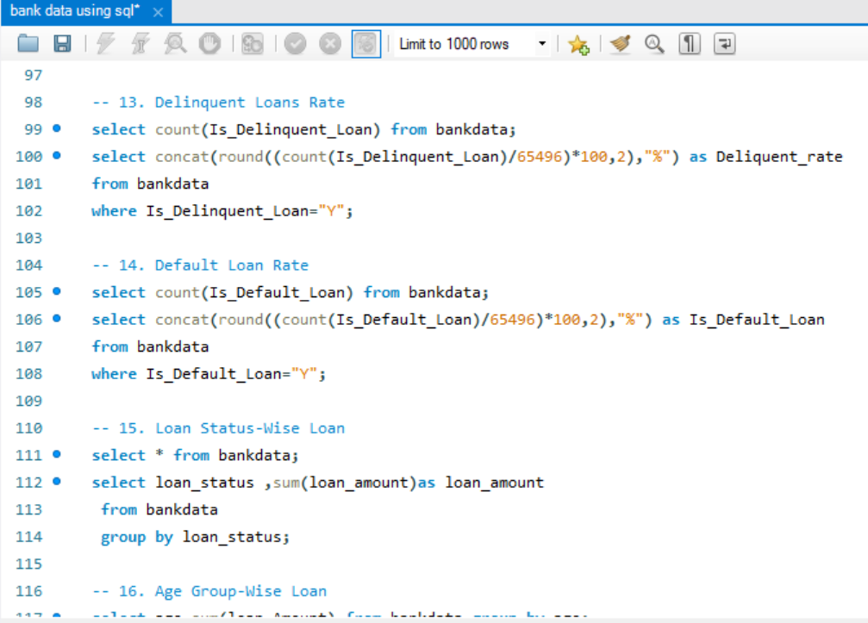
MYSQL QUERIES

Slide 20
Recommendations and Insights
Optimize Branch Performance: Focus on high-performing branches like Mathura, Patiala, and Jalandhar, while improving underperforming ones.
Manage Loan Risks: Analyze default & delinquency rates, apply stricter risk assessments, and refine lending policies.
Age & Loan Maturity Strategy: Offer financial education for young borrowers (18-25) and optimize loan tenure based on repayment trends.
Product & State-Level Insights: Expand high-demand loans (Mortgage & Rent Loans) in top states like Uttar Pradesh, Punjab, and Bihar.
Interest Rate & Fee Adjustments: Adjust interest rates & fees to improve profitability while maintaining affordability.
Enhance Collection & Recovery: Use predictive analytics for late fee tracking & recoveries, and proactively follow up on high-risk clients.

Slide 21
Conclusion
The analysis of bank loan data underscores the need for strategic improvements in branch performance, risk mitigation, loan structuring, and collection efficiency. Optimizing high-performing branches while addressing underperforming ones can enhance overall financial outcomes. Implementing data-driven risk assessments and refining lending policies will help minimize defaults and delinquency rates. Additionally, state-wise expansion of high-demand loan products, coupled with interest rate and fee optimizations, can drive sustainable growth. Leveraging predictive analytics for collection and recovery efforts will further strengthen financial stability. By adopting these strategies, the bank can enhance operational efficiency, improve loan portfolio performance, and achieve long-term profitability.

